Slide 1
Automotive Systems – Perception and situation understanding Simulative Robot Detection with different sensors and Kalman-filter
Prof. Dr.-Ing. Raoul Zöllner
Johannes Buyer, M. Eng.
lgerstla@stud.hs-heilbronn.de, jkurz1@stud.hs-heilbronn.de

Slide 2
Problem description
Observation of Robots in a room
Two Cameras with limited Field of View
One Lidar with low angular resolution
Only position measurable
Known state Equation of robots

Slide 3
Boundary conditions
Room Size 2D = [40 m, 30 m]
Cameras
Located in the upper two corners of the room
FOV of 40.0 degrees
Measures position in x and y
Normally distributed uncertainty with sigma of 0.2
Lidar
Located in the lower middle of the room
Angular resolution of 10 degrees
Measures distance to robot and angle of hitten beam
Normally distributed uncertainty of distance with sigma of 0.2, angular sigma 0.1

Slide 4
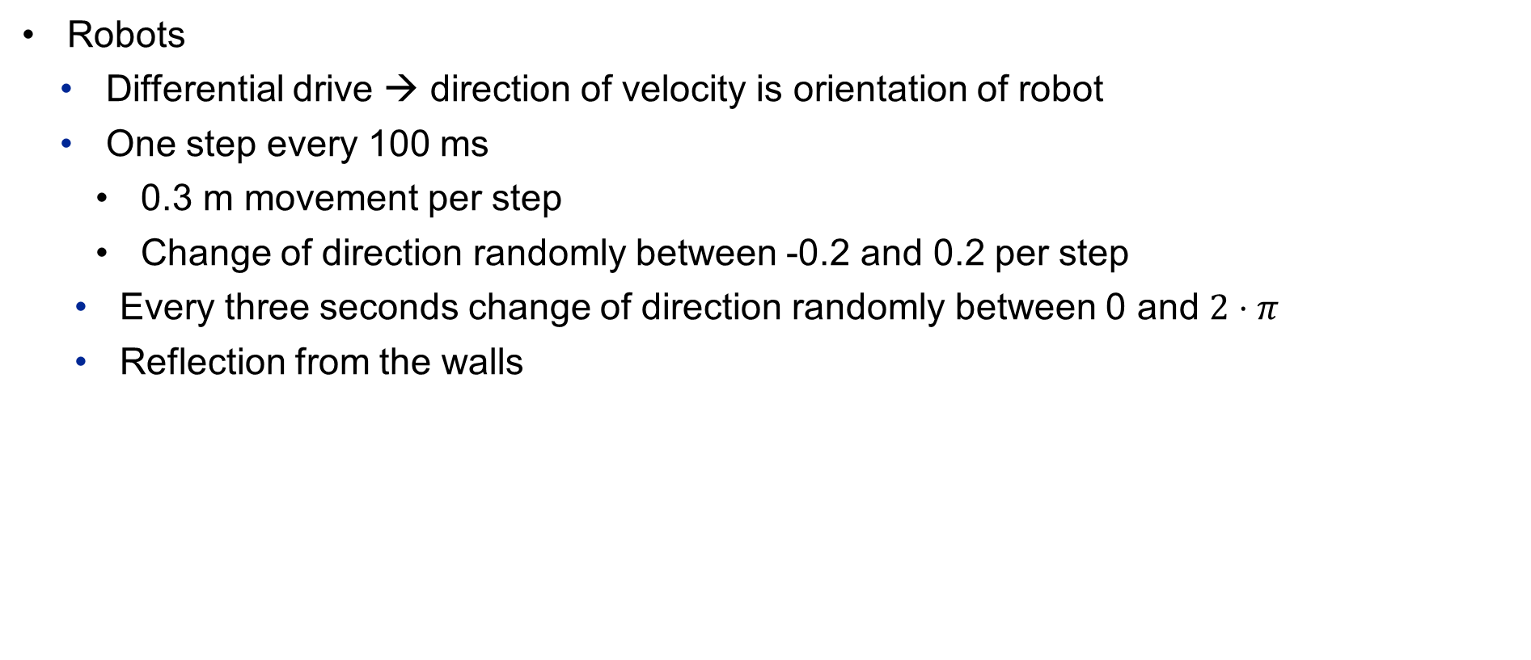
Boundary conditions
Robots
Differential drive → direction of velocity is orientation of robot
One step every 100 ms
0.3 m movement per step
Change of direction randomly between -0.2 and 0.2 per step
Every three seconds change of direction randomly between 0 and $2⋅π$
Reflection from the walls

Slide 5
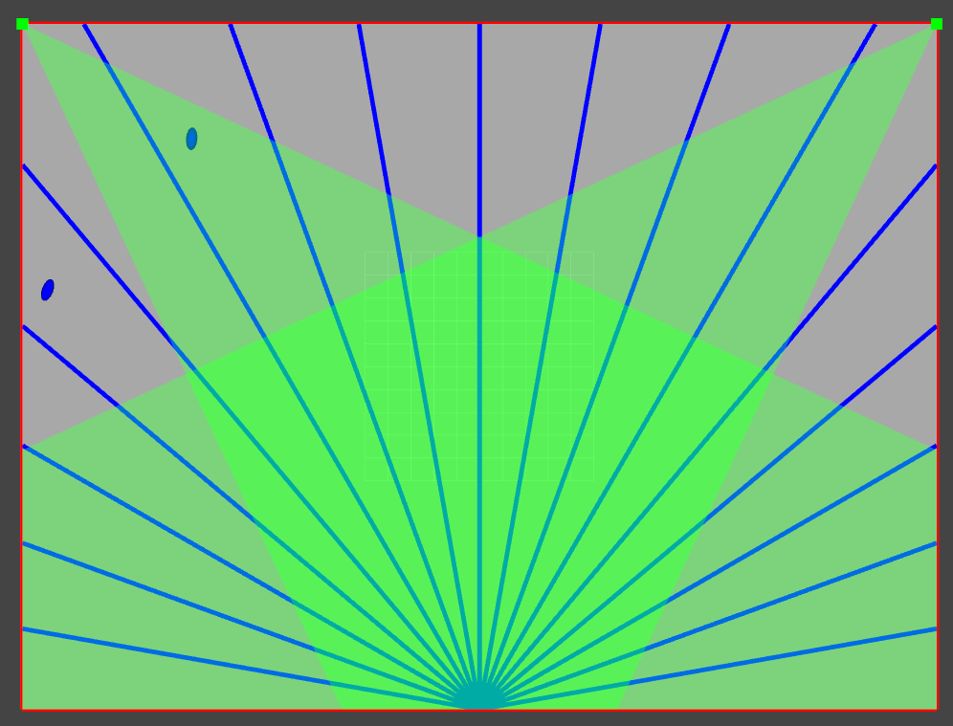
Visualization of room, Sensors and robots

Slide 6
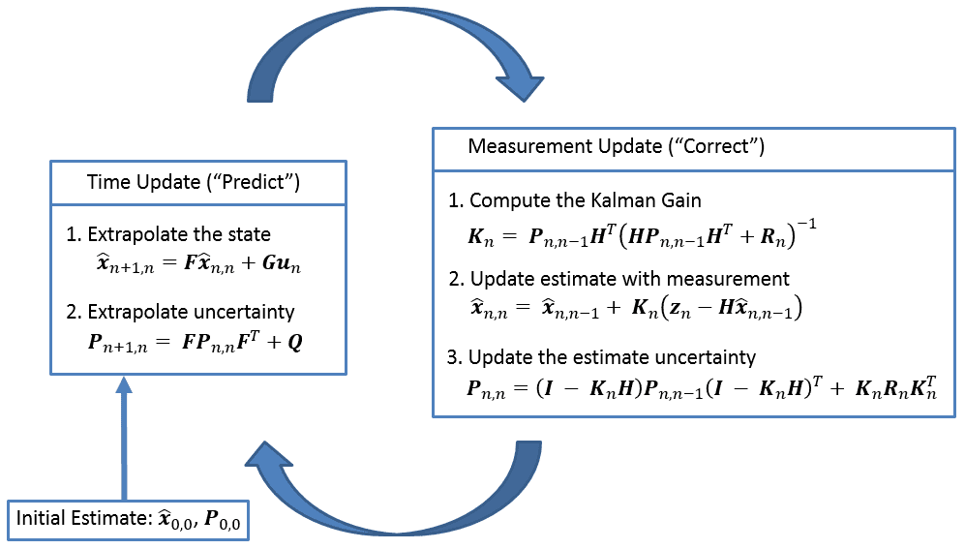
Chosen solution approach
Multi Target Tracking with Mahalanobis distance-based data association
Extended Kalman-Filer
https://www.kalmanfilter.net/img/summary/KalmanFilterDiagram.png

Slide 7
Mulit Target Tracking
Mahalanobis distance

Slide 8

State vector, measurement vector
State vector: $x=\left[\begin{matrix}x \\ y \\ \begin{aligned}θ \\ v \\ ω\end{aligned}\end{matrix}\right]$
Input vector: $u=[ ]$
Measurement vector: $z_{camera}=\left[\begin{matrix}x \\ \begin{aligned}y \\ θ\end{aligned}\end{matrix}\right]$
$z_{lidar}=\left[\begin{matrix}x \\ y\end{matrix}\right]$

Slide 9

Motion / Transition Model
System dynamics function$: f\left(x\right)=\left[\begin{matrix}x+v⋅\cos\left(θ_{k}\right)⋅dt \\ y+v⋅\sin\left(θ_{k}\right)⋅dt \\ θ+ω⋅dt \\ v \\ ω\end{matrix}\right]$

Slide 10

Measurement Model
Measurement function: $h_{camera}\left(x\right)=\left[\begin{matrix}x \\ \begin{aligned}y \\ θ\end{aligned}\end{matrix}\right]$
$h_{lidar}(x)=\left[\begin{matrix}x \\ y\end{matrix}\right]$

Slide 11
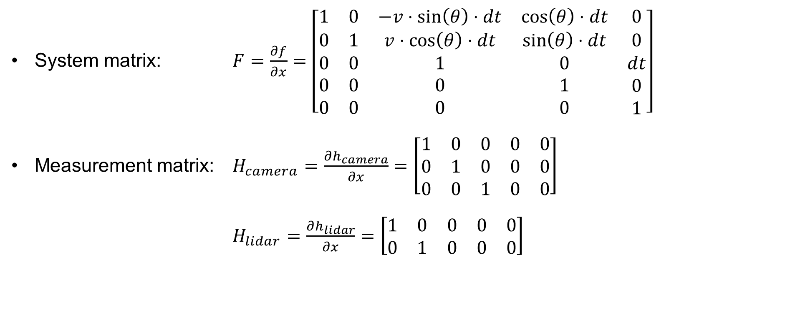
Jacobi-matrices
System matrix: $F=\frac{∂f}{∂x}=\left[\begin{matrix}1 & 0 & −v⋅\sin\left(θ\right)⋅dt & \cos\left(θ\right)⋅dt & 0 \\ 0 & 1 & v⋅\cos\left(θ\right)⋅dt & \sin\left(θ\right)⋅dt & 0 \\ \begin{aligned}0 \\ 0 \\ 0\end{aligned} & \begin{aligned}0 \\ 0 \\ 0\end{aligned} & \begin{aligned}1 \\ 0 \\ 0\end{aligned} & \begin{aligned}0 \\ 1 \\ 0\end{aligned} & \begin{aligned}dt \\ 0 \\ 1\end{aligned}\end{matrix}\right]$
Measurement matrix: $H_{camera}=\frac{∂h_{camera}}{∂x}=\left[\begin{matrix}1 & 0 & 0 & 0 & 0 \\ 0 & 1 & 0 & 0 & 0 \\ 0 & 0 & 1 & 0 & 0\end{matrix}\right]$
$H_{lidar}=\frac{∂h_{lidar}}{∂x}=\left[\begin{matrix}1 & 0 & 0 & 0 & 0 \\ 0 & 1 & 0 & 0 & 0\end{matrix}\right]$

Slide 12
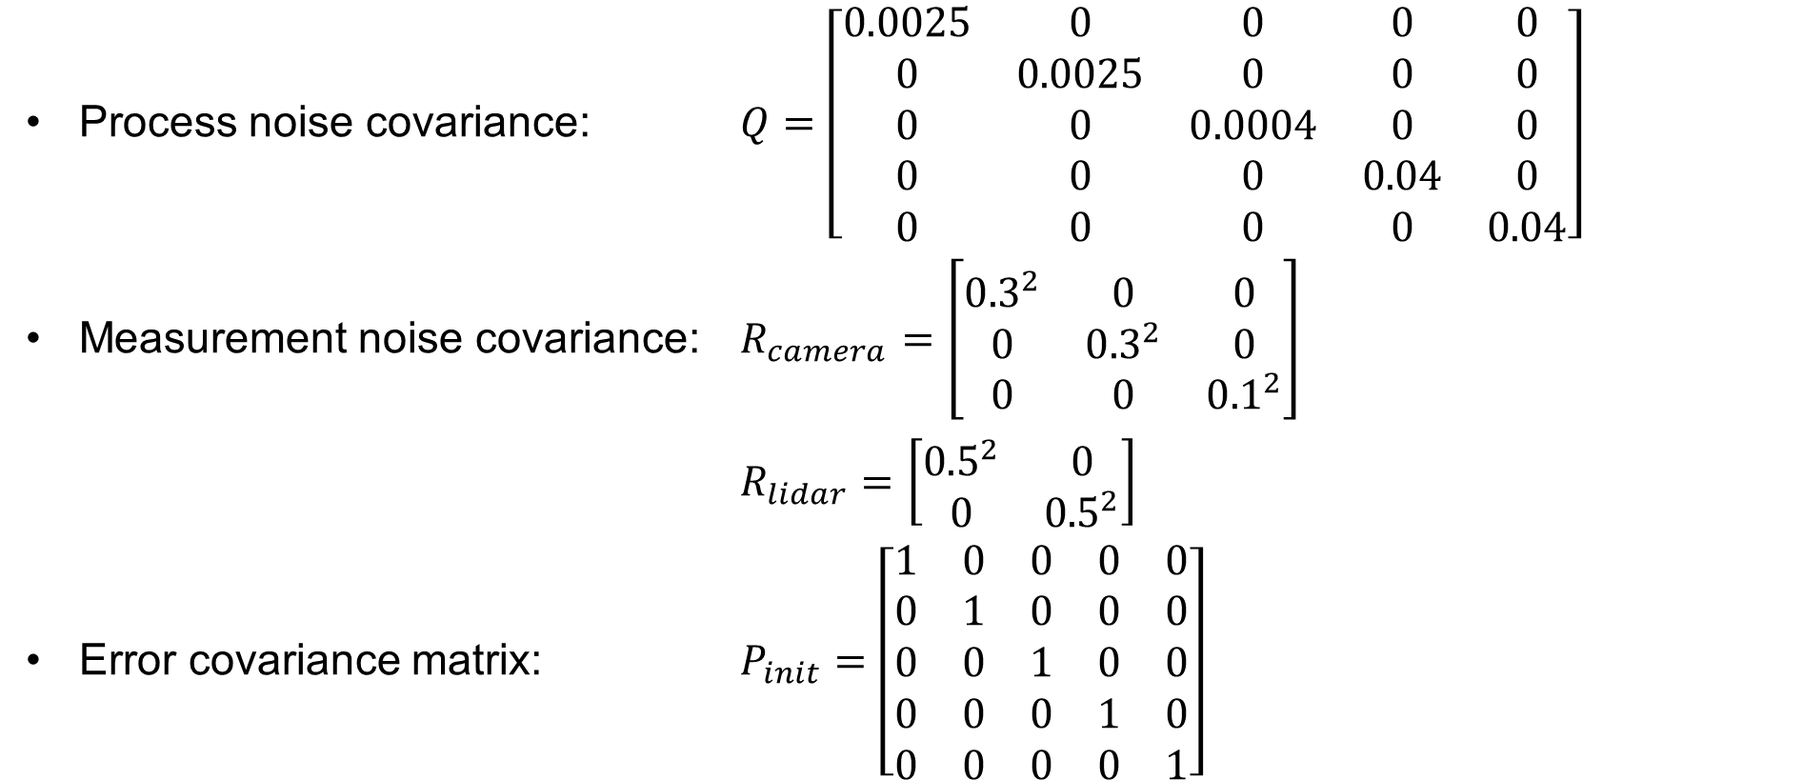
Parameterization of the filter
Process noise covariance: $Q=\left[\begin{matrix}0.0025 & 0 & 0 & 0 & 0 \\ 0 & 0.0025 & 0 & 0 & 0 \\ 0 & 0 & 0.0004 & 0 & 0 \\ 0 & 0 & 0 & 0.04 & 0 \\ 0 & 0 & 0 & 0 & 0.04\end{matrix}\right]$
Measurement noise covariance: $R_{camera}=\left[\begin{matrix}{0.3}^{2} & 0 & 0 \\ 0 & {0.3}^{2} & 0 \\ 0 & 0 & {0.1}^{2}\end{matrix}\right]$
$R_{lidar}=\left[\begin{matrix}{0.5}^{2} & 0 \\ 0 & {0.5}^{2}\end{matrix}\right]$
Error covariance matrix: $P_{init}=$ $\left[\begin{matrix}1 & 0 & 0 & 0 & 0 \\ 0 & 1 & 0 & 0 & 0 \\ 0 & 0 & 1 & 0 & 0 \\ 0 & 0 & 0 & 1 & 0 \\ 0 & 0 & 0 & 0 & 1\end{matrix}\right]$

Slide 13
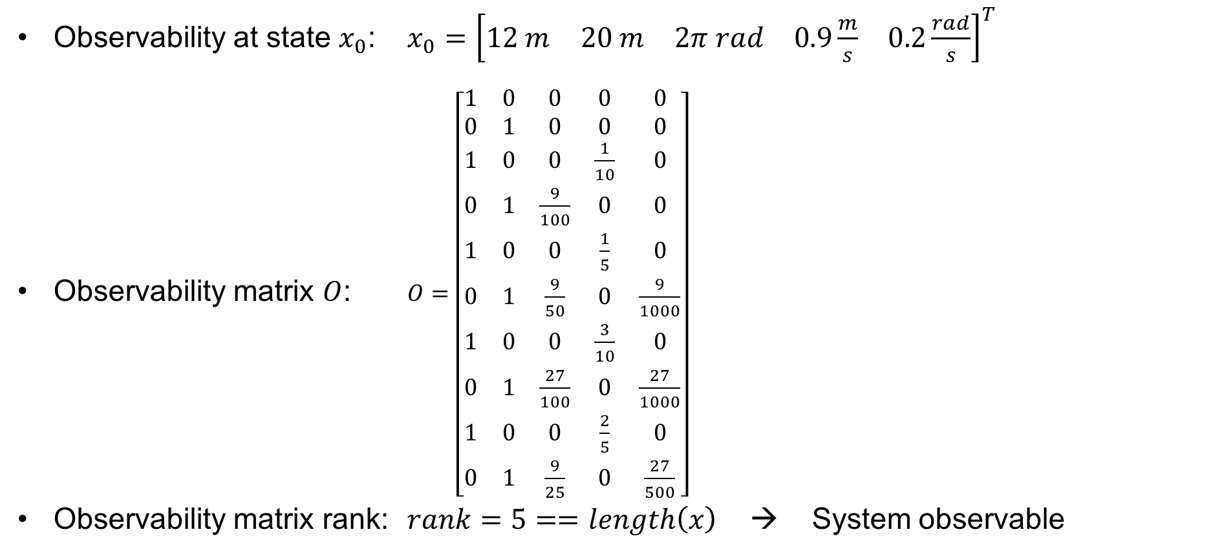
observability
Observability at state $x_{0}$: $x_{0}={\left[\begin{matrix}12 m & 20 m & 2π rad & 0.9\frac{m}{s} & 0.2\frac{rad}{s}\end{matrix}\right]}^{T}$
Observability matrix $O$: $O=\left[\begin{matrix}1 & 0 & 0 & 0 & 0 \\ 0 & 1 & 0 & 0 & 0 \\ 1 & 0 & 0 & \frac{1}{10} & 0 \\ 0 & 1 & \frac{9}{100} & 0 & 0 \\ 1 & 0 & 0 & \frac{1}{5} & 0 \\ 0 & 1 & \frac{9}{50} & 0 & \frac{9}{1000} \\ 1 & 0 & 0 & \frac{3}{10} & 0 \\ 0 & 1 & \frac{27}{100} & 0 & \frac{27}{1000} \\ 1 & 0 & 0 & \frac{2}{5} & 0 \\ 0 & 1 & \frac{9}{25} & 0 & \frac{27}{500}\end{matrix}\right]$
Observability matrix rank: $rank=5==length\left(x\right)$ → System observable

Slide 14
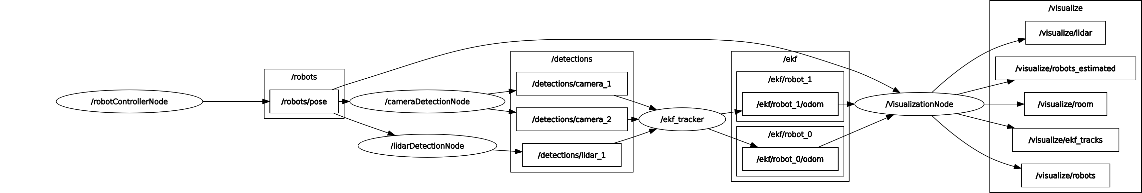
Structure of the implemented program
Implementation in ROS2 Nodes
robotControllerNode → Simulation of roboter movement
*DetectionNode → Simulation of detection with added noise
ekfNode → extended Kalman-Filter
visualizationNode → Visualization of room, roboters, sensors, covariance

Slide 15
performed experiments and results

Slide 16
Literature

Slide 17
Thank you for your attention

